Slide 1
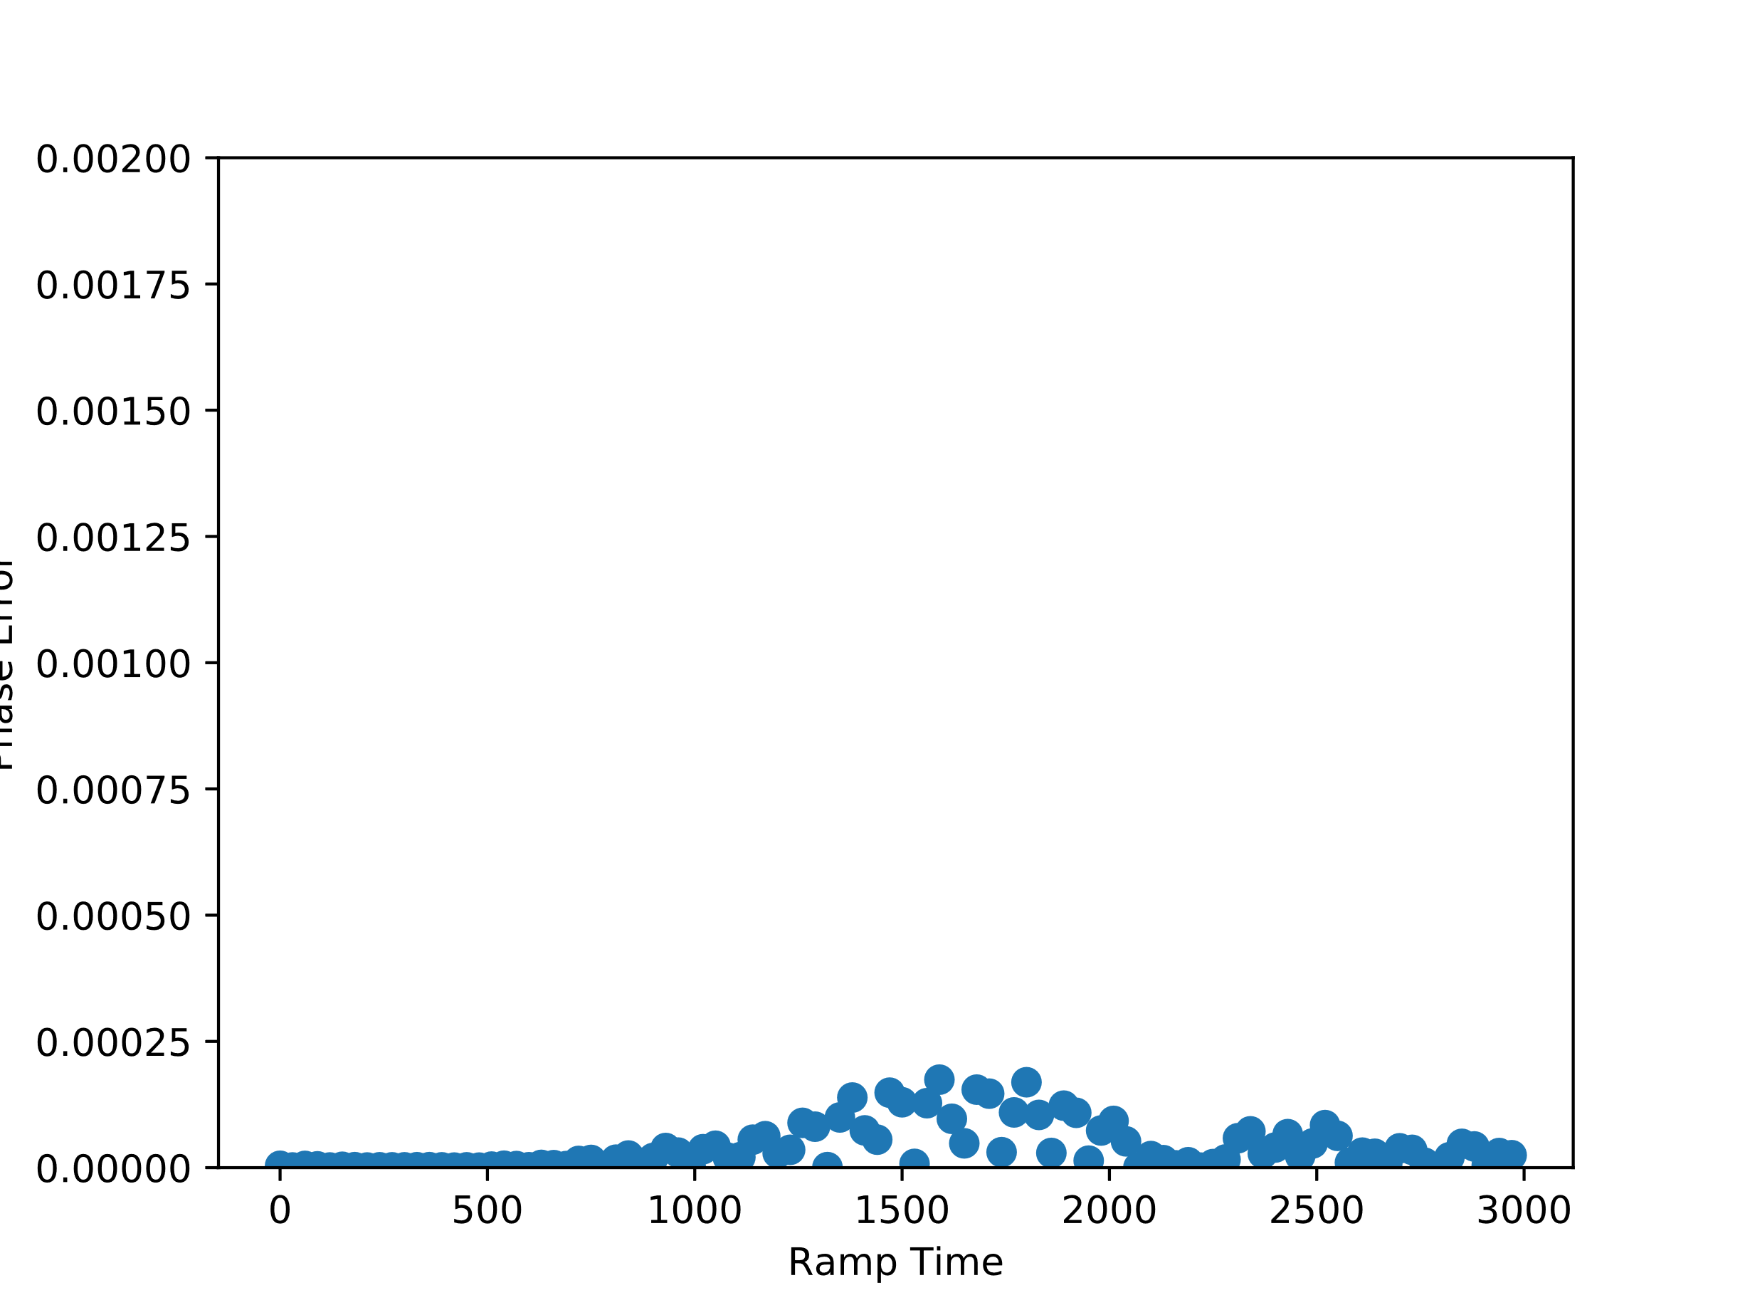
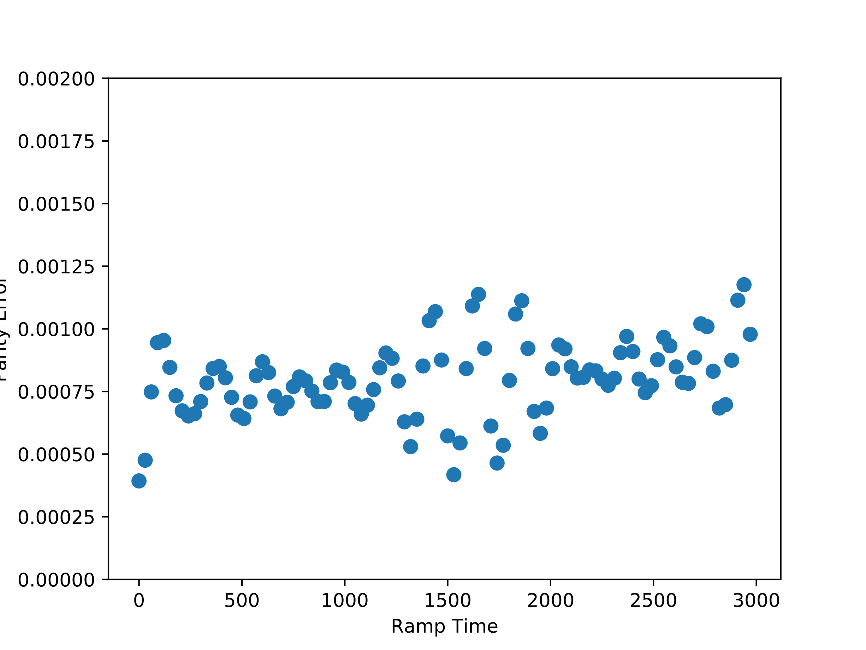
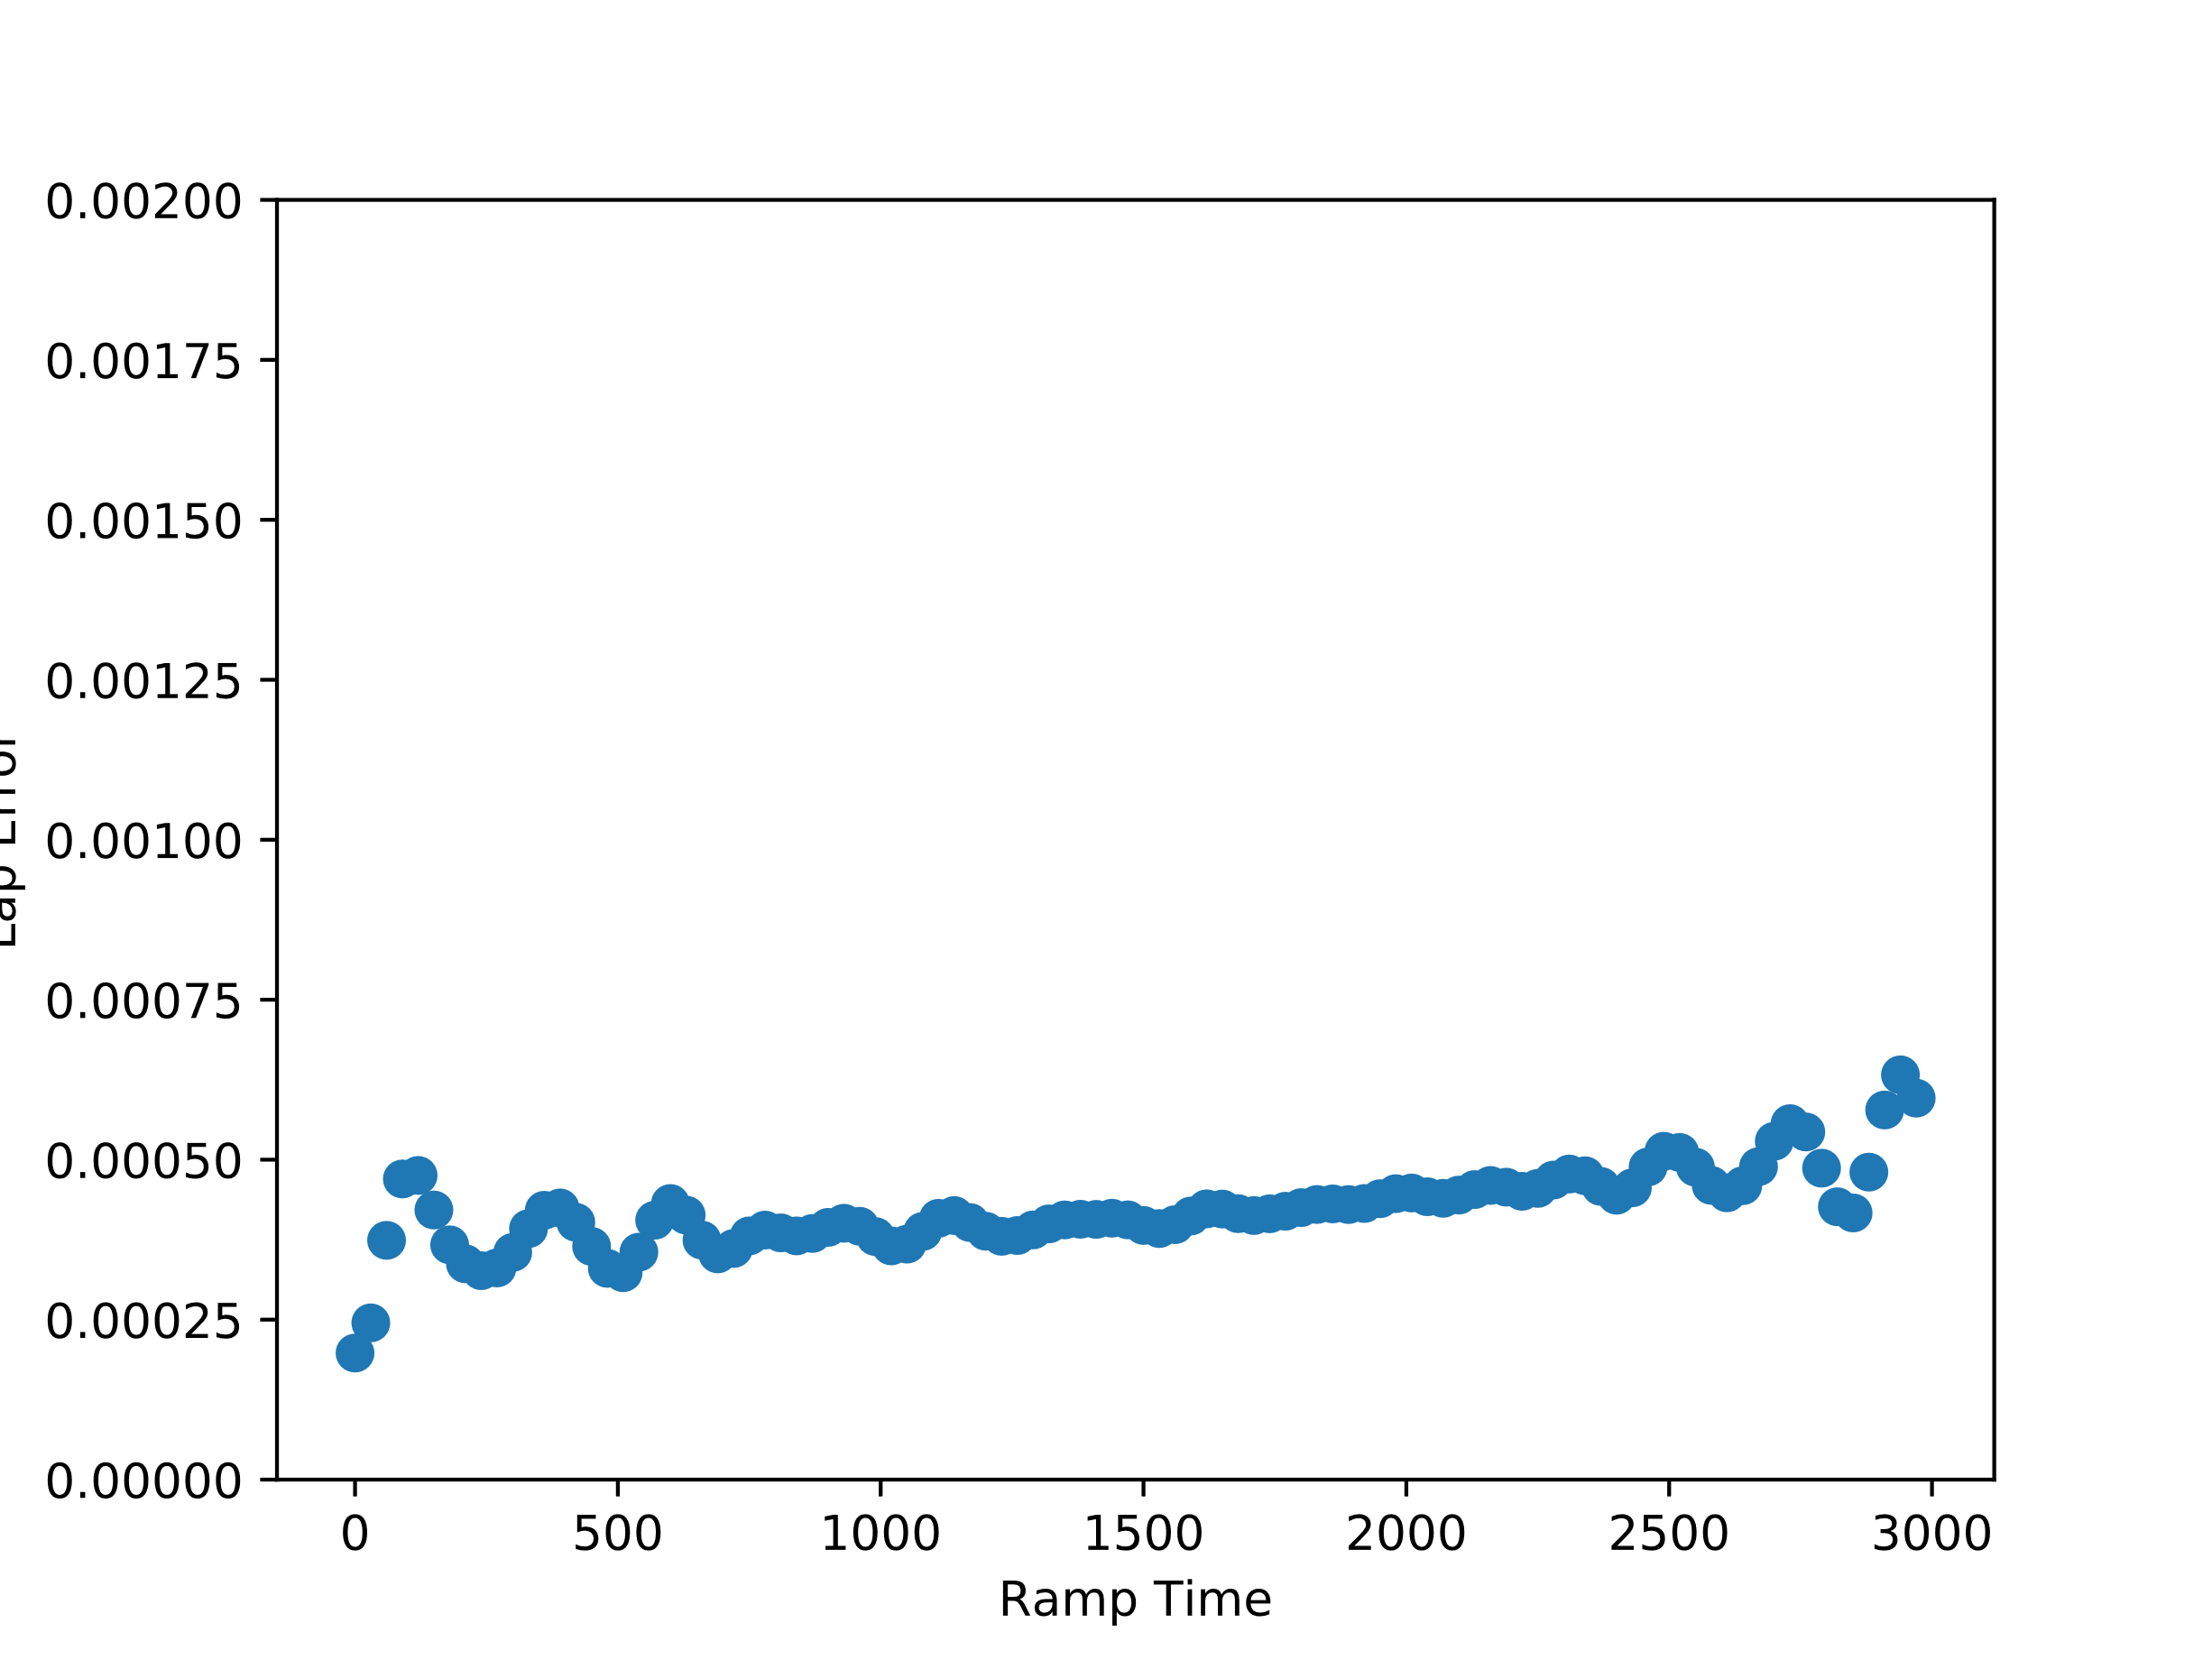
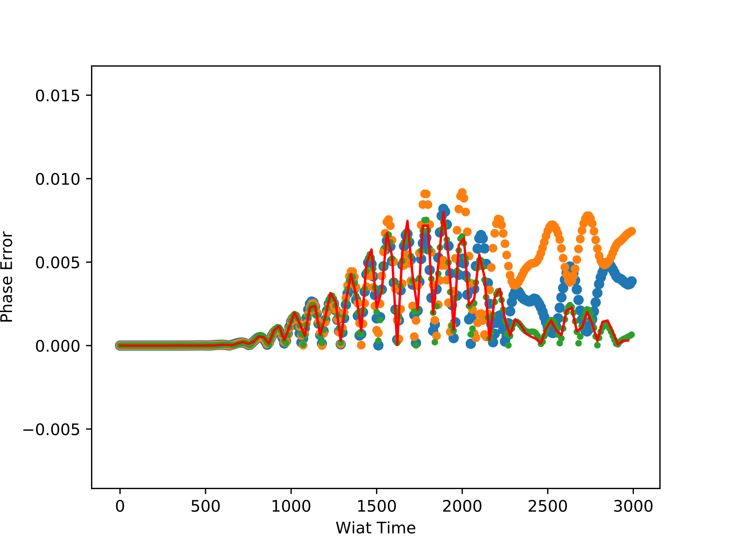
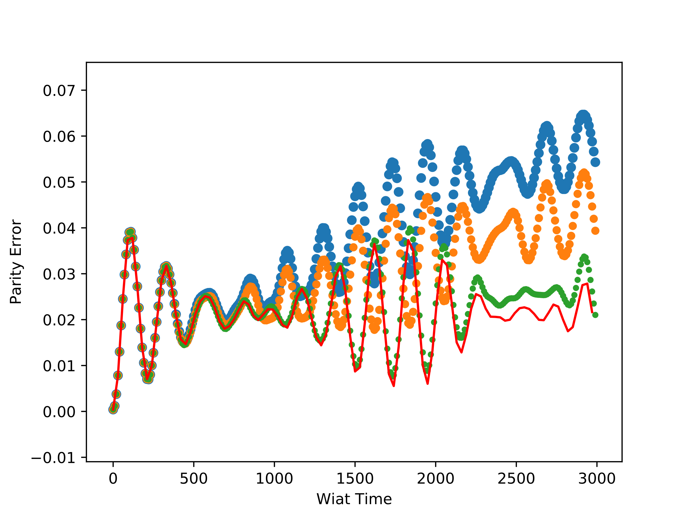
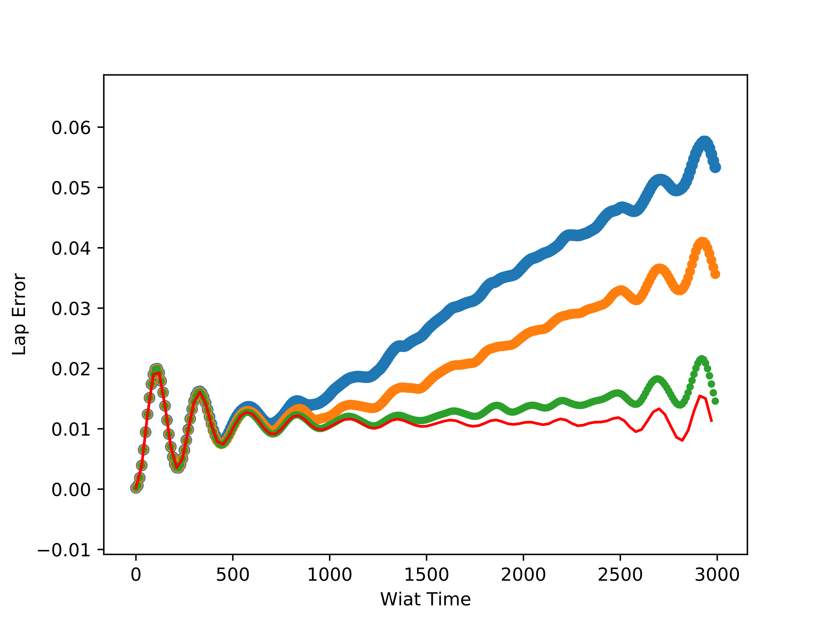

L=26, t=1.0, $Δ=0.7$, $μ=0.2,$ Vmax=0.1
BD=40 tr=500
BD=40 tr=100
n=10 (8,L-8)
n=6 (10,L-10)
n=2 (L/2-1,L/2)
n=0

Slide 2
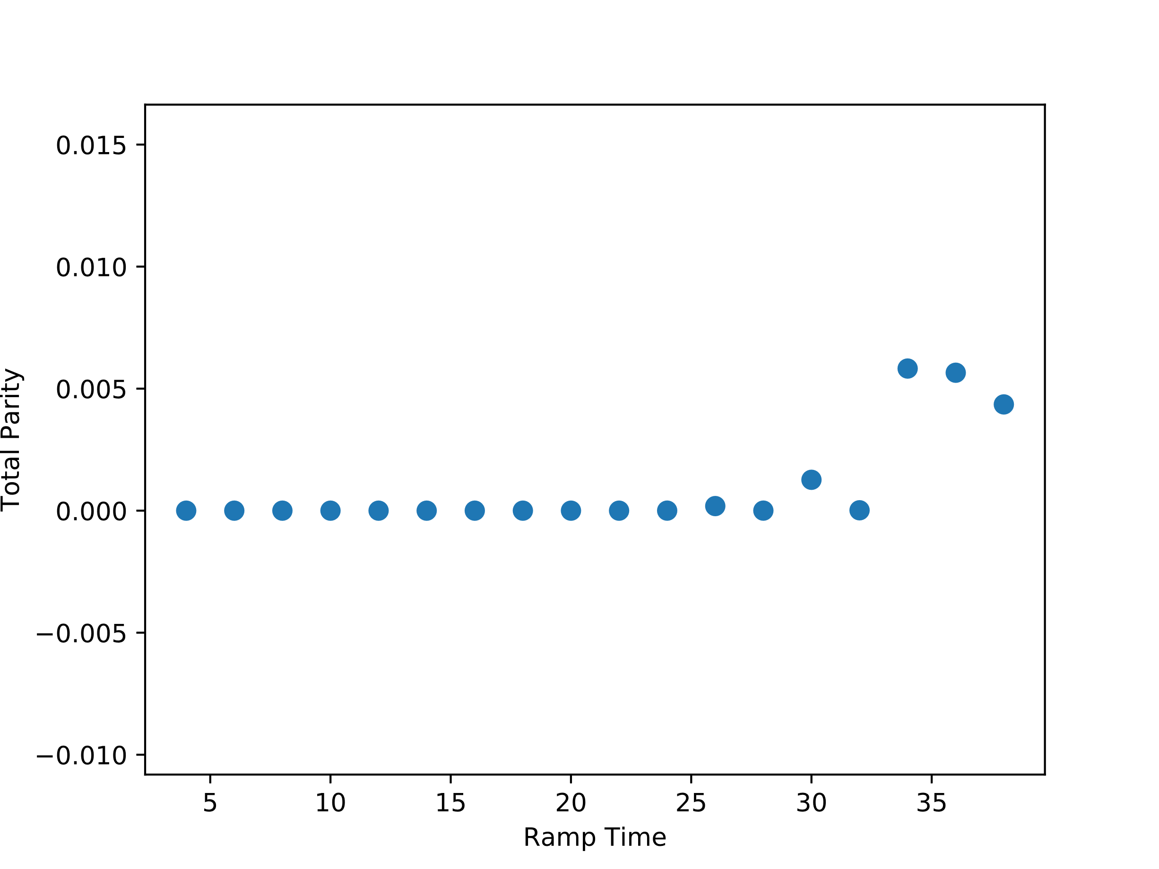
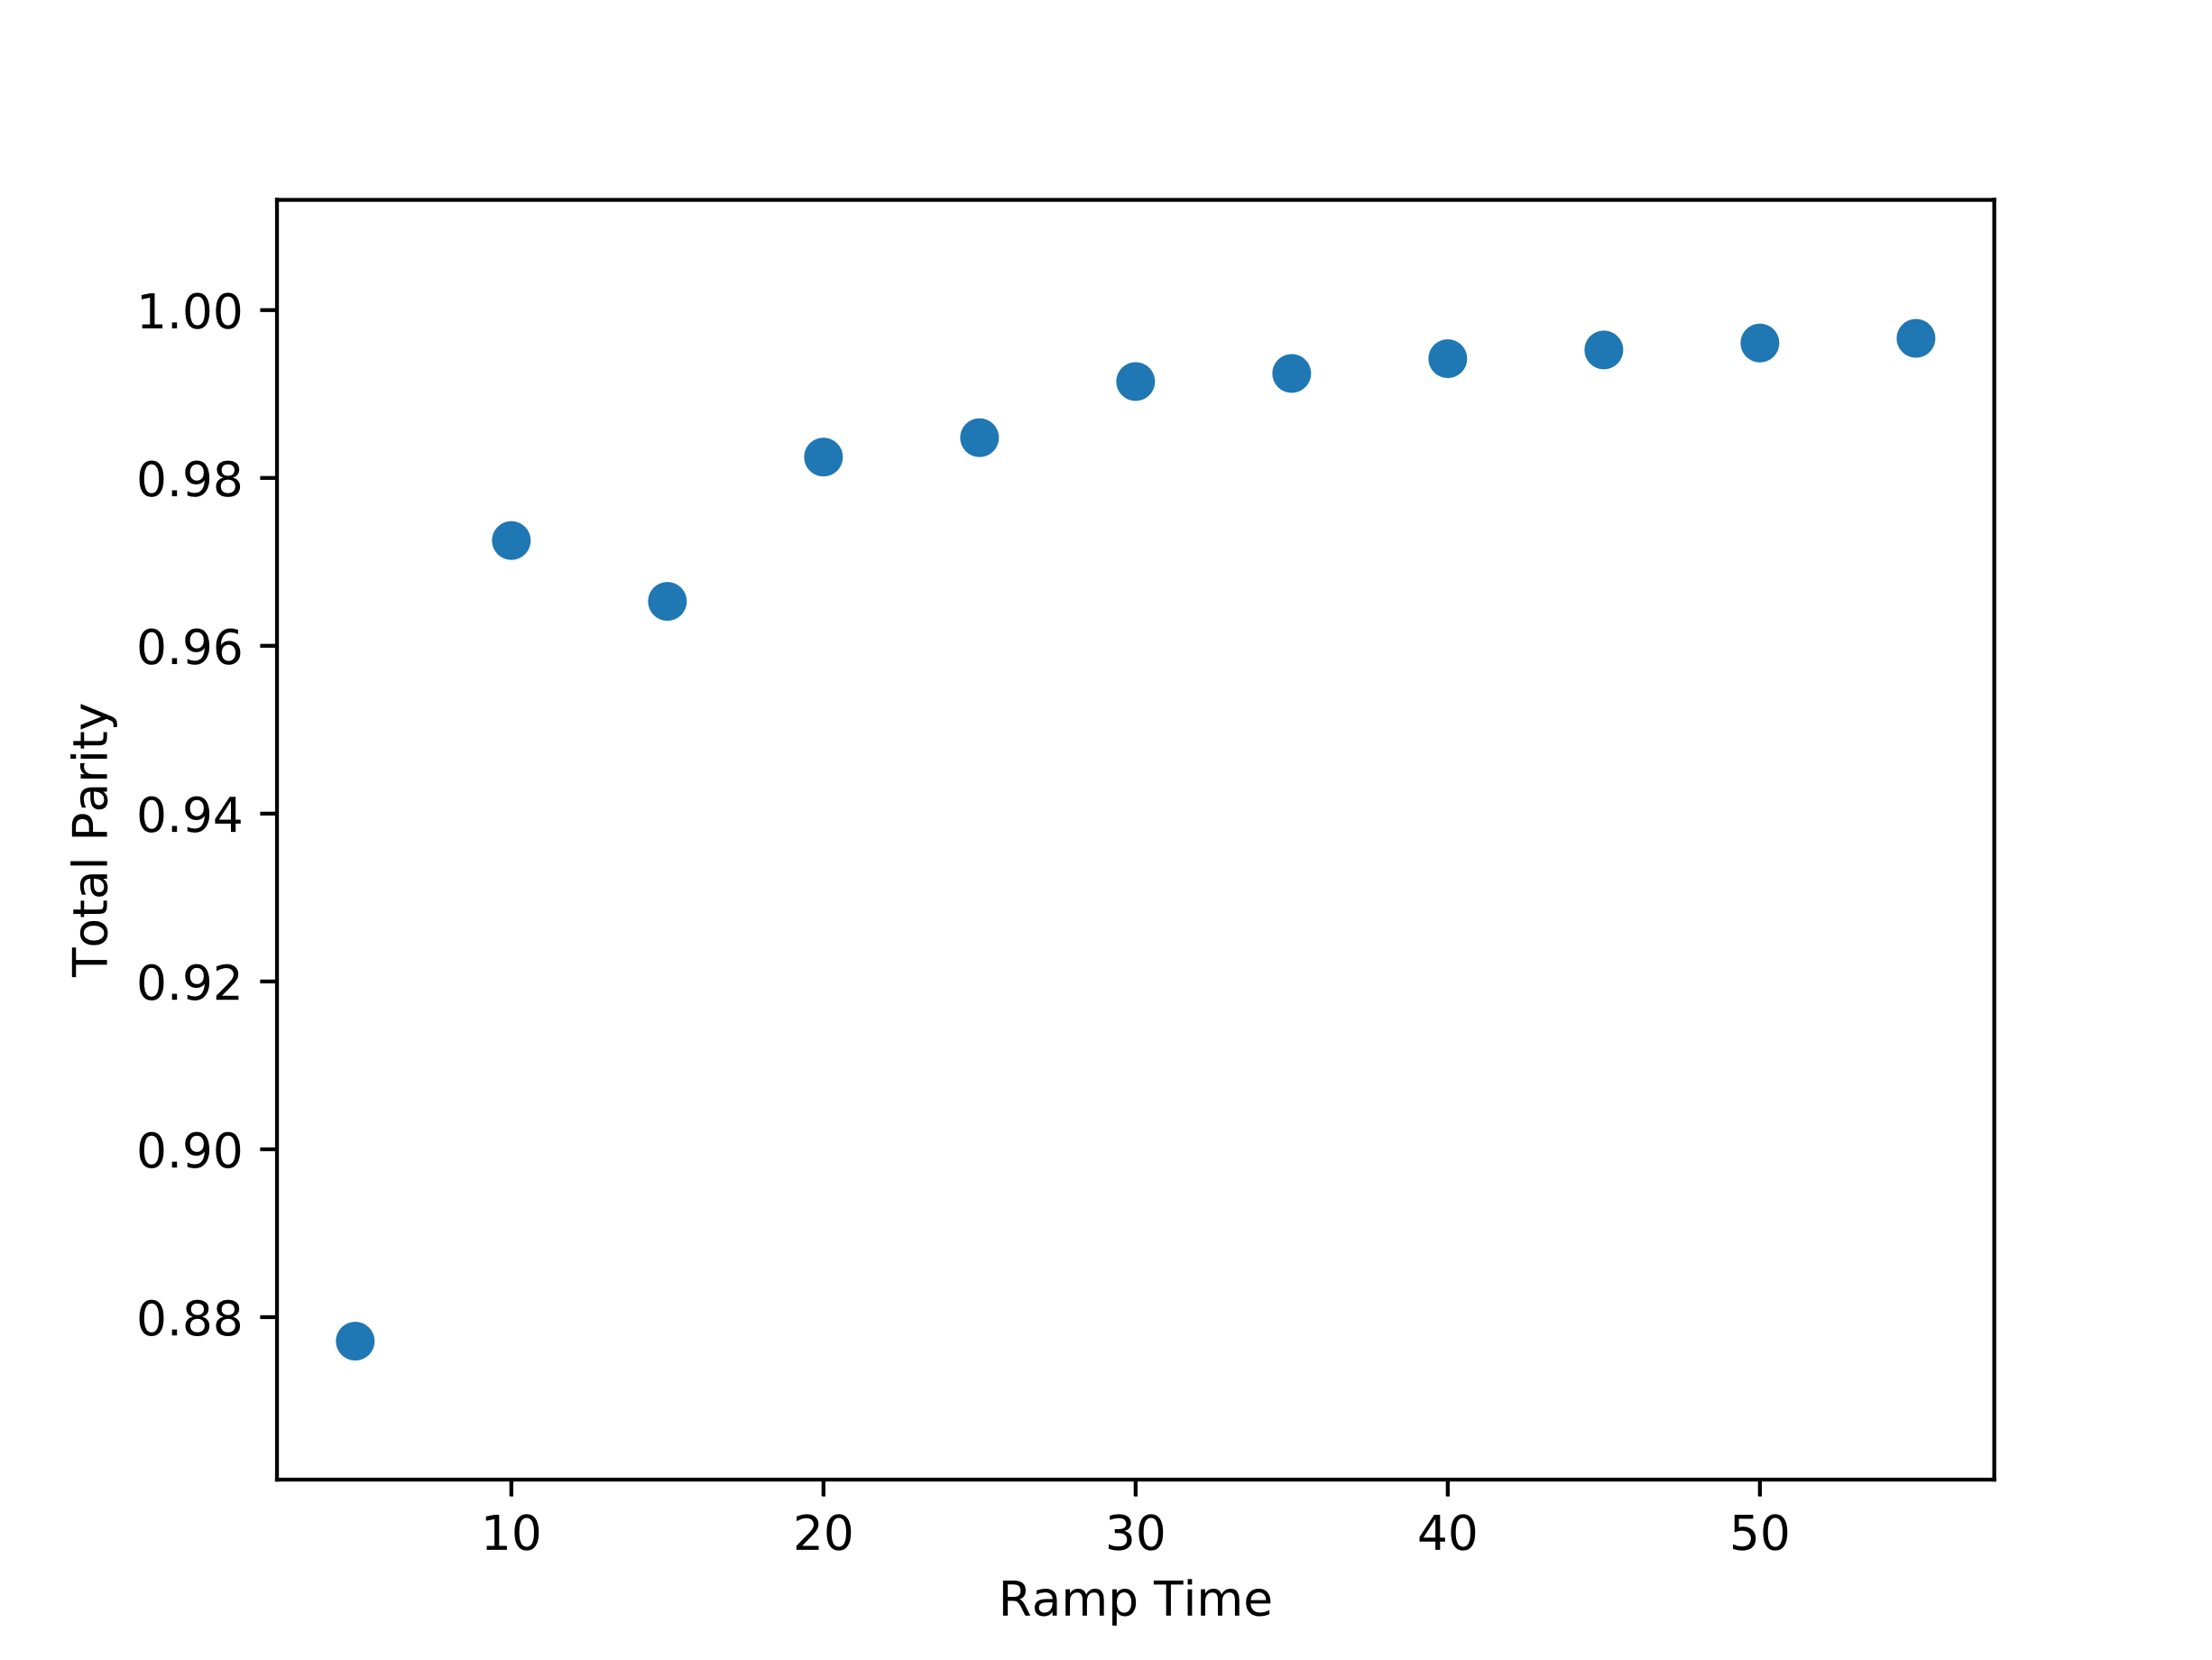
L=26, t=1.0, $Δ=0.7$, $μ=0.2,$ Vmax=0.1
BD=40 tr=500, tw=3000

Slide 3
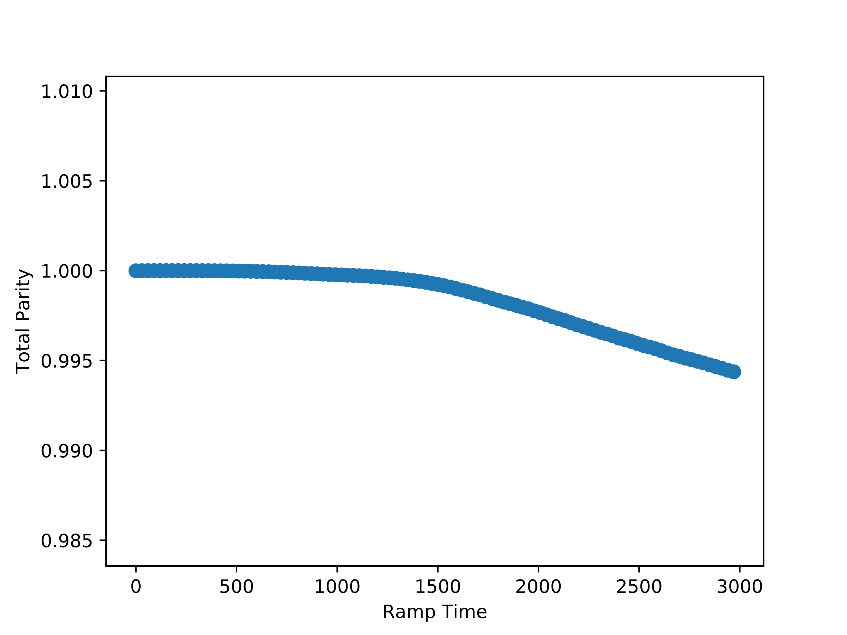
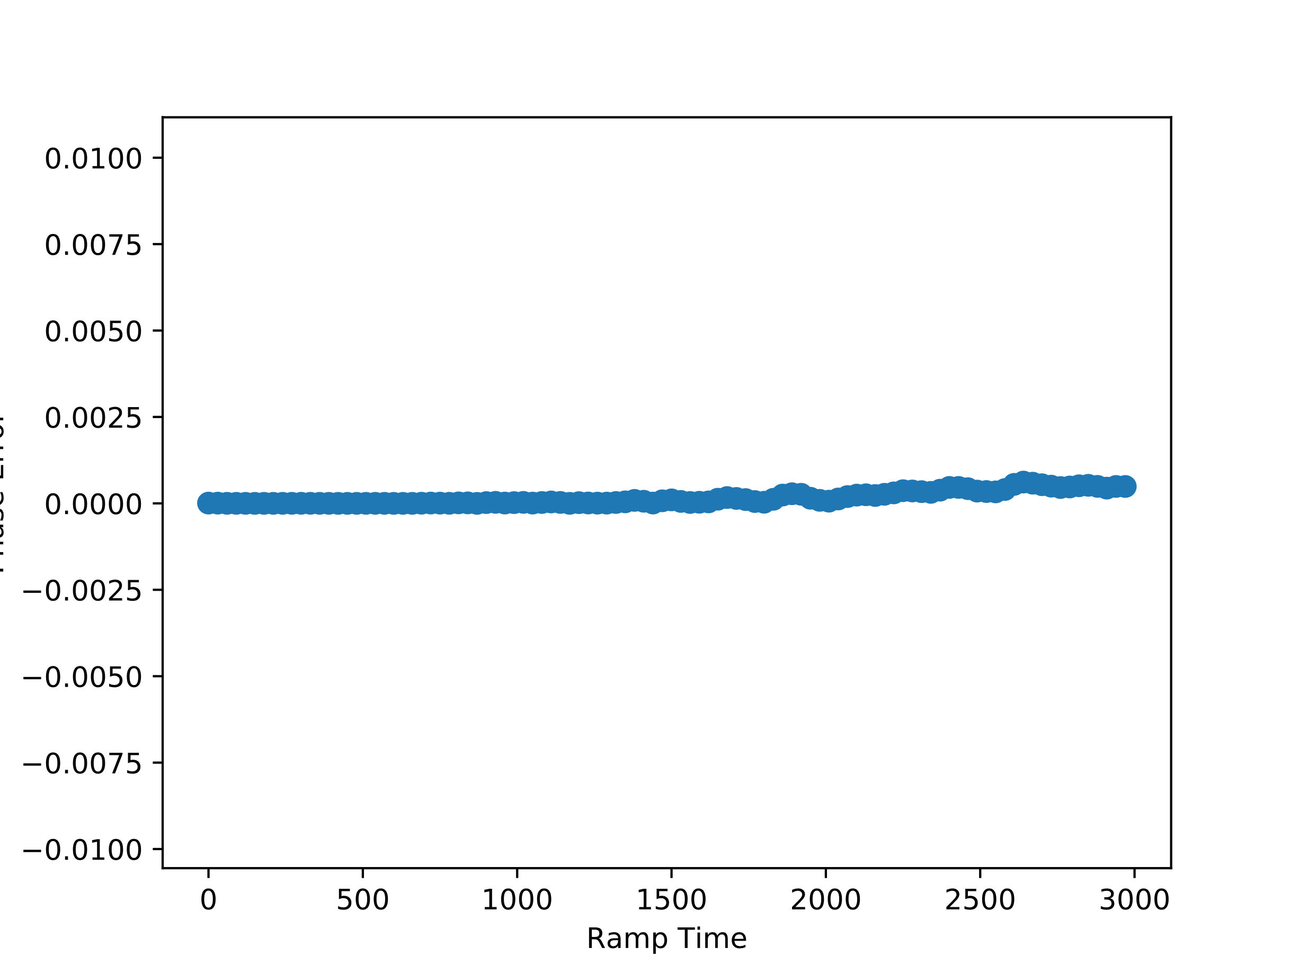
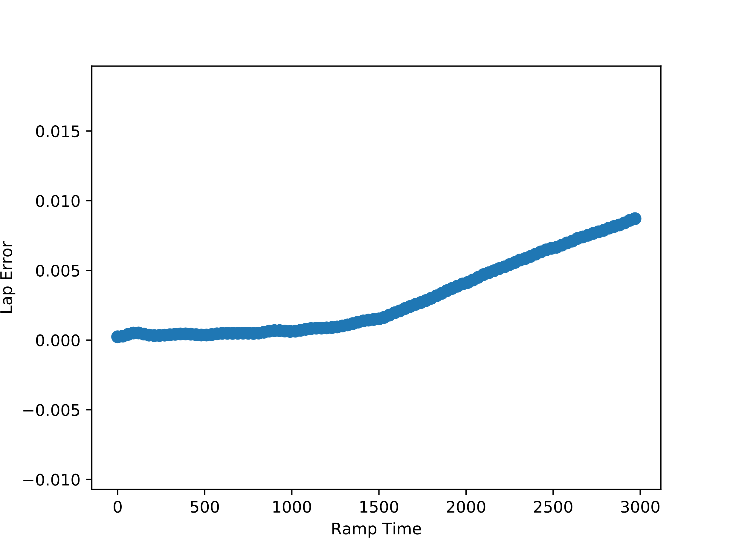
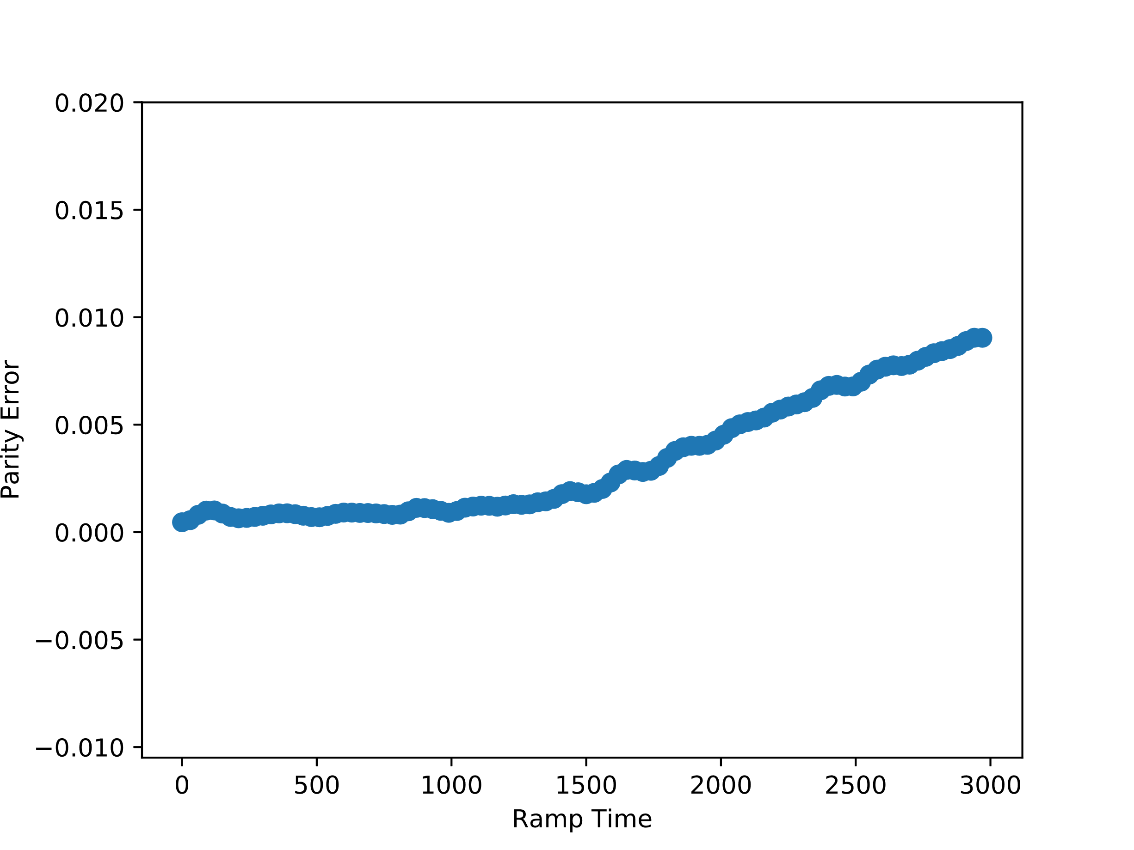
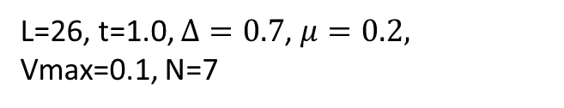
L=26, t=1.0, $Δ=0.7$, $μ=0.2,$ Vmax=0.1, N=7
BD=40 tw=3000

